Slide 1
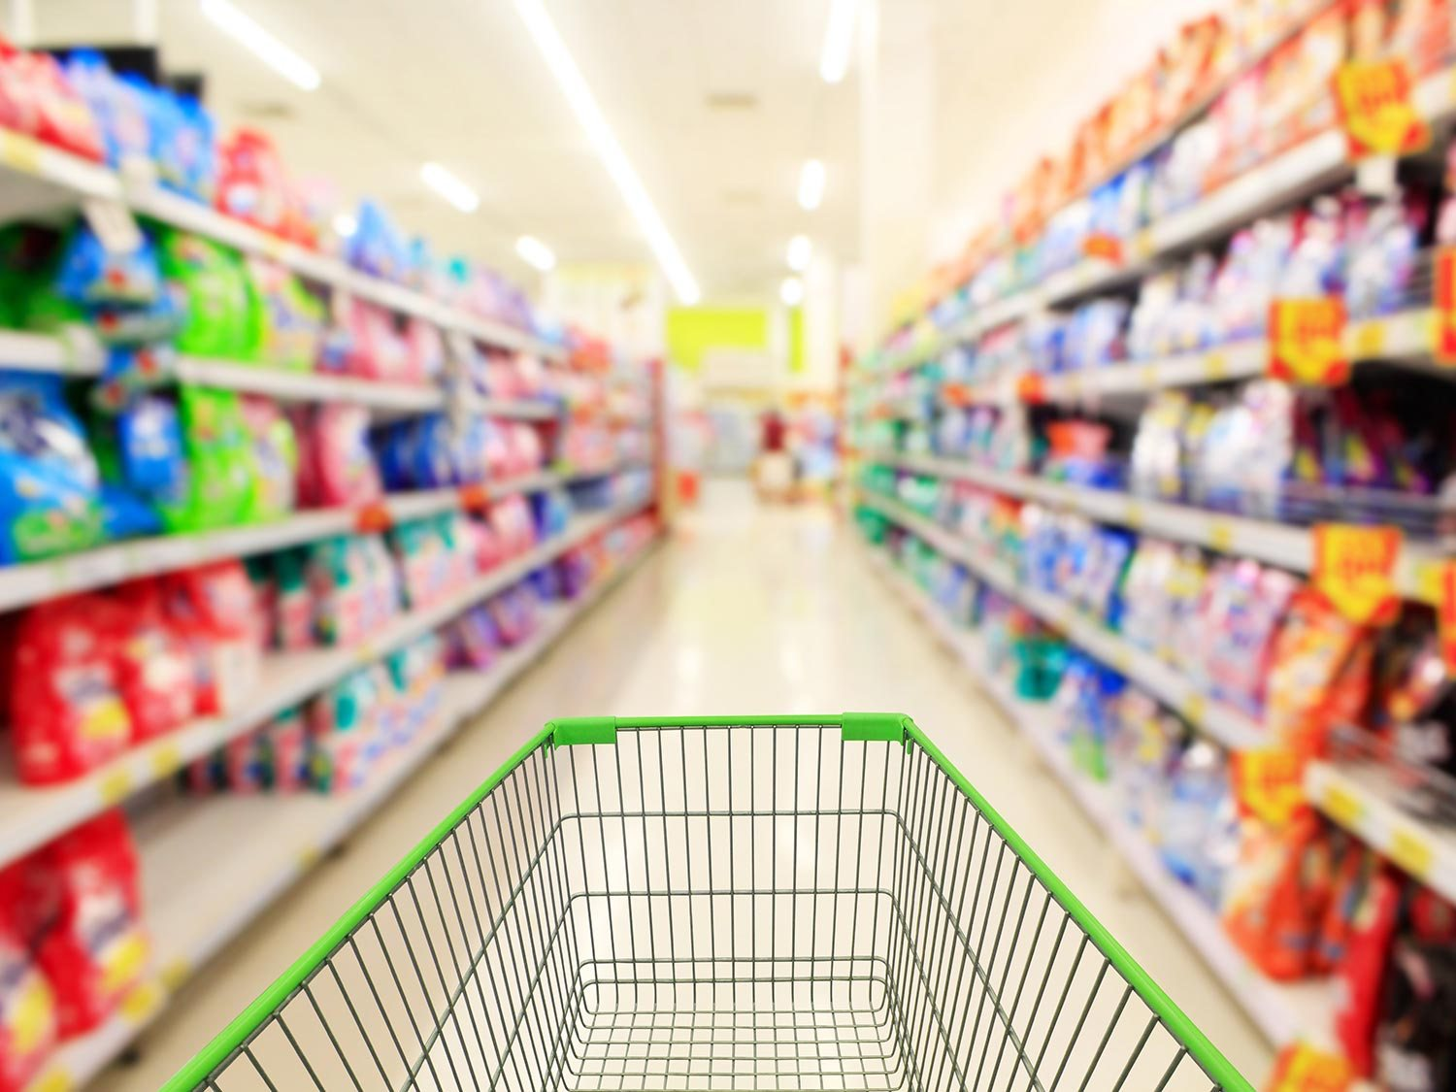
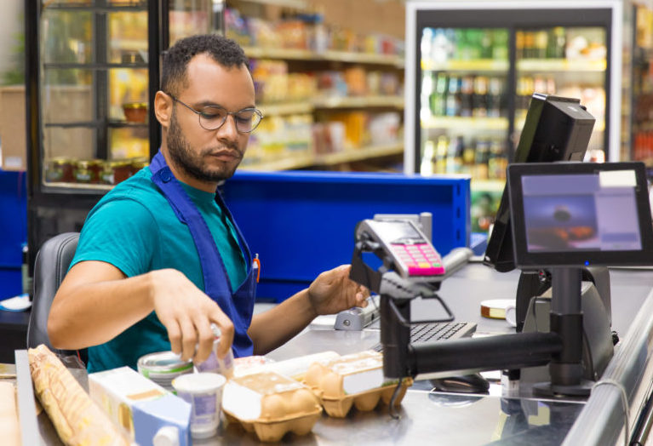
SUPERMARKET INVENTORY AND SALES MANAGEMENT SYSTEM

Slide 2
SUPERMARKET INVENTORY AND SALES MANAGEMENT SYSTEM
This project aims at automation of various management procedures such as managing sales and purchases, stock details, etc.
All the details and records in the supermarket are maintained in a file system.
Various operations like insertion, modification and deletion operations are done over the files to manage data

Slide 3
REQUIREMENTS
We use python programming language for developing the back-end and front-end of the project.
Front end is developed using PyQt5 library in python.
We use four files for managing the project
A category file is maintained to manage all the product category available in the supermarket
A brand file is maintained to manage different product brands.
A product file is maintained to manage different products with all it’s details such as name, brand, category, stock available, prize etc.
A purchase file will be managed for managing sales made from the supermarket
There will be different pages for purchasing, adding new product, updating stock, viewing stock and for viewing the sales history

Slide 4
INSERTION
Adding new product brand
Adding new product type
Adding new product with details and stock available

Slide 5
MODIFICATION
Updating current stock available
Updating the price of the product

Slide 6
DELETION
Deleting a product brand
Deleting a product type
Deleting a product

Slide 7
Thank you

